Slide 1


PCAP | Programming essentials in Python
overview
developed by

Slide 2

CONTENTS
OVERVIEW
COURSE DESIGN
SCOPE AND SEQUENCE
HOW TO USE THE COURSE
CERTIFICATION
WHY LEARN PROGRAMMING
WHY LEARN PYTHON
PYTHON EXAMPLES
KEY TAKEAWAYS
© 2017 PYTHON Institute and/or affiliates | ALL RIGHTS reserved.
1

Slide 3

overview
PCAP | PROGRAMMING ESSENTIALS IN PYTHON
For beginners with little or no prior knowledge of programming.
Designed to be a full-semester course: 5 modules, 5 quizzes, 5 module assessments, 30+ lab exercises, 2 summary tests, and 1 final test.
Accessed online with no special equipment or system requirements.
Instructor-led training offered at no cost.
Self-paced access offered at no cost (not available yet).
© 2017 PYTHON Institute and/or affiliates | ALL RIGHTS reserved.
2

Slide 4
TARGET AUDIENCE
The PCAP | Programming Essentials in Python curriculum is designed for students with little or no prior knowledge of programming.
CURRICULUM DESCRIPTION
The PCAP | Programming Essentials in Python course covers all the basics of programming in Python, as well as general computer programming concepts and techniques. The course also familiarizes the student with the object-oriented approach.
TARGET CERTIFICATION
The PCAP | Programming Essentials in Python curriculum helps students prepare for the PCAP | Python Certified Associate Programmer certification exam, available from February 2018. PCAP | Python Certified Associate Programmer is a professional certification that measures the student’s ability to accomplish coding tasks related to the basics of programming in the Python language, and the fundamental notions and techniques used in object-oriented programming.

Slide 5
course design
The course is broken down into 5 modules (+ one optional module):
Module 1
Familiarize the student with the basic methods offered by Python of formatting and outputting data, together with the primary kinds of data and numerical operators, their mutual relationships and binding. Introduce the concept of variables and variable naming conventions. Present the assignment operator, along with the rules governing the building of expressions. Introduce the inputting and converting of data.
Module 2
Familiarize the student with the concept of Boolean values, in order to compare difference values and control the execution paths using the if and if-else instructions. Introduce the utilization of loops (while and for) and how to control their behavior using the break and continue instructions. Present the difference between logical and bitwise operations. Acquaint the student with the concept of lists and list processing, including the iteration provided by the for loop, and slicing. Explain the idea of multi-dimensional arrays.
© 2017 PYTHON Institute and/or affiliates | ALL RIGHTS reserved.
4

Slide 6
course design
Module 3
Acquaint the student with the defining and using of functions – their rationale, purpose, conventions, and traps. Present the concept of passing arguments in different ways and setting their default values, along with the mechanisms of returning the function’s results. Explain name scope issues. Introduce new data aggregates: tuples and dictionaries, and show their role in data processing.
Module 4
Familiarize the student with Python modules: their rationale, function, how to import them in different ways, and present the content of some standard modules provided by Python. Present the way in which modules are coupled together to make packages. Acquaint the student with the concept of an exception and Python’s implementation of it, including the try-except instruction, with its applications, and the raise instruction. Introduce strings and their specific methods, together with their similarities and differences compared to lists.
© 2017 PYTHON Institute and/or affiliates | ALL RIGHTS reserved.
5

Slide 7
course design
Module 5
Acquaint the student with the fundamentals of OOP (Object Oriented Programming) and the way they are adopted in Python, showing the difference between OOP and the classical, procedural approach. Present the standard objective features: inheritance, abstraction, encapsulation, and polymorphism, along with Python-specific issues like instance vs. class variables, and Python’s implementation of inheritance. Exceptions are discussed again in a more detailed way, showing their objective nature. Familiarize the student with Python’s generators (the yield instruction) and closures (the lambda keyword). Demonstrate the means Python developers can use to process (create, read, and write) files.
Module 0 (optional)
Familiarize the student with the fundamentals of computer programming: how the computer works, how the program is executed, how the programming language is defined and constructed, what the difference is between compilation and interpretation, what Python is, how it is positioned among other programming languages, and what distinguishes the different versions of Python. Demonstrate a simple way to download, install, and run the Python environment on a personal computer.
© 2017 PYTHON Institute and/or affiliates | ALL RIGHTS reserved.
6

Slide 8
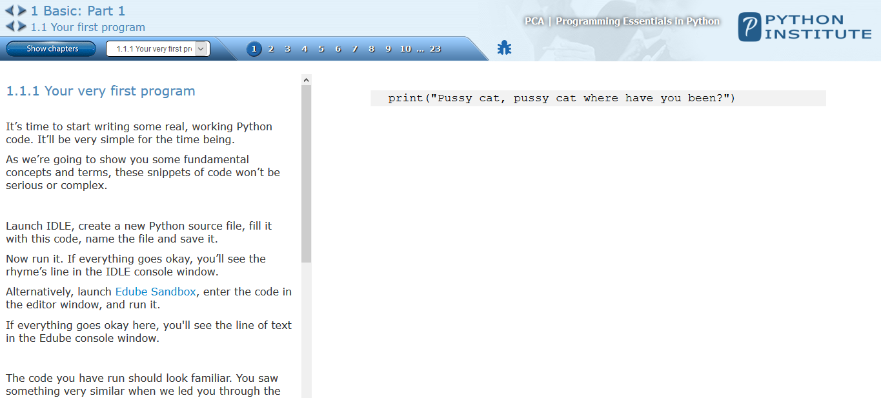
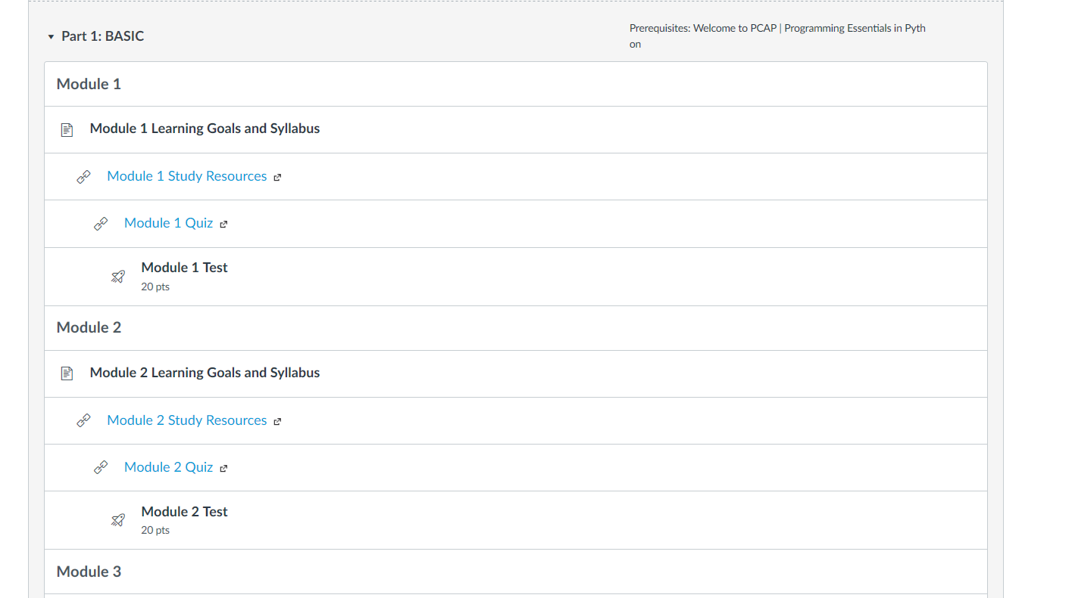
COURSEWARE
Course Content
Course Page in NetSpace

Slide 9
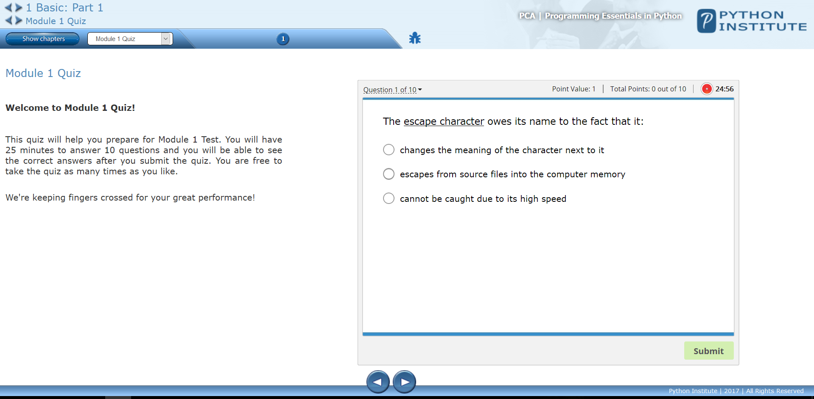
COURSEWARE
Quizzes

Slide 10
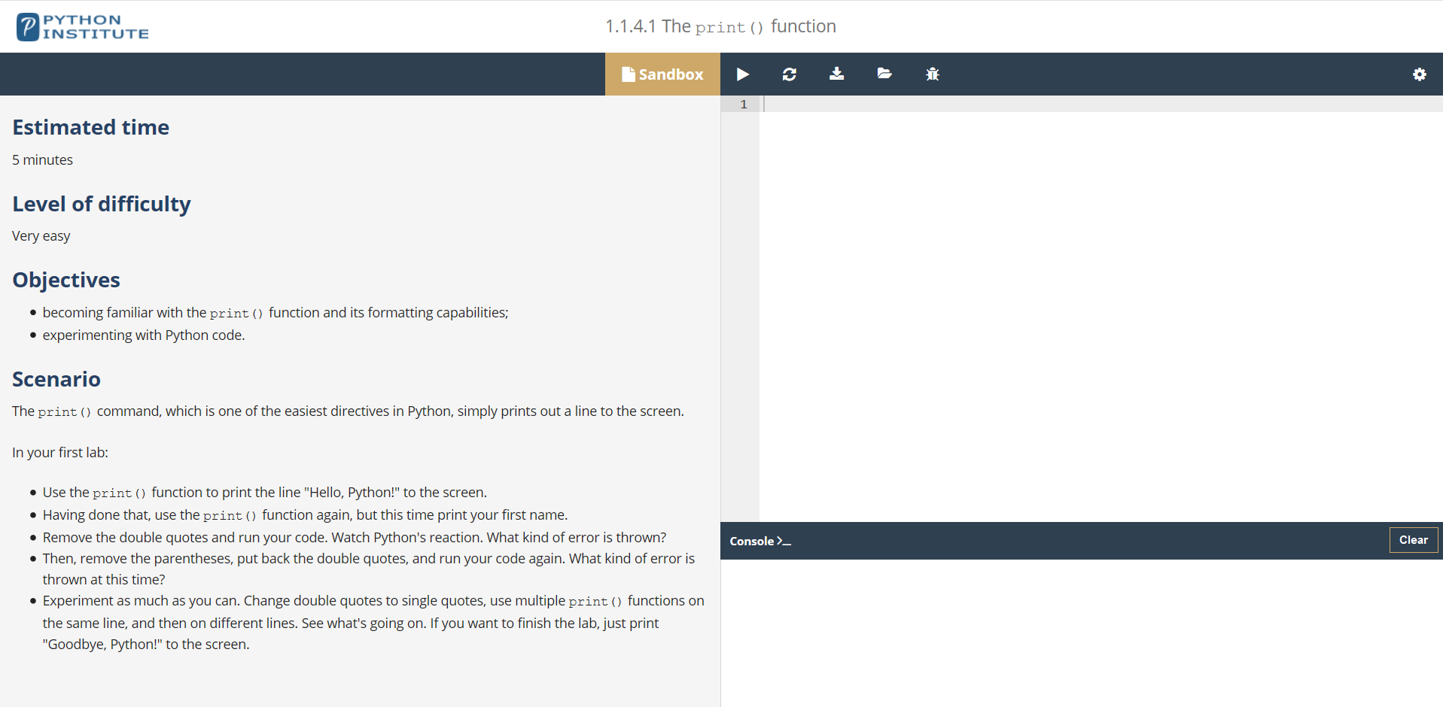
COURSEWARE
Labs

Slide 11
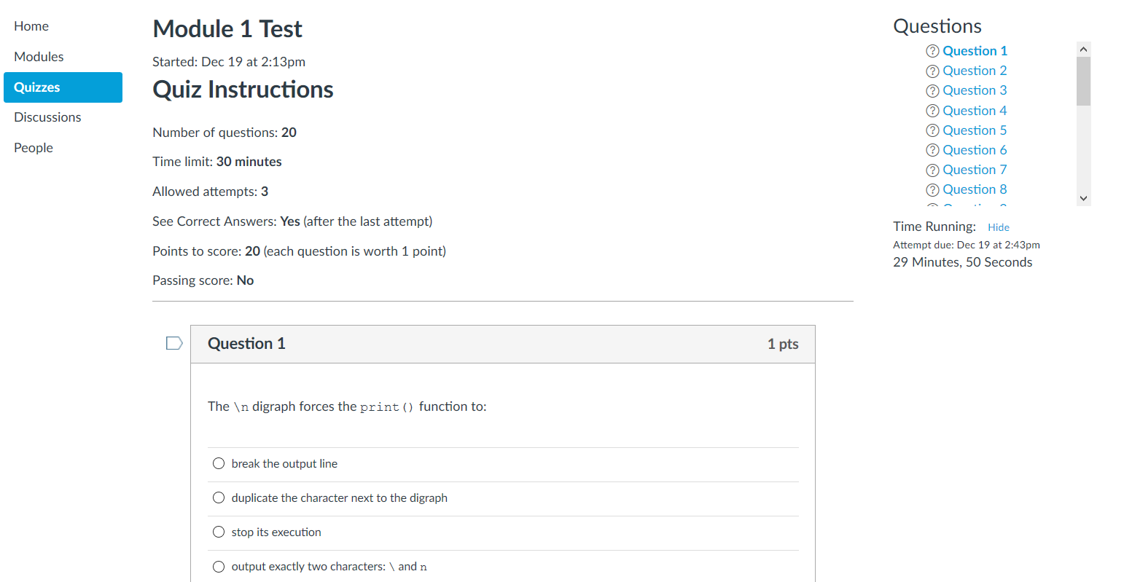
COURSEWARE
Module Tests

Slide 12
SCOPE AND SEQUENCE
CURRICULUM OBJECTIVES
The aim of the course is to:
familiarize the student with the universal concepts of computer programming,
present the Python programming language syntax, semantics, and the runtime environment,
acquaint the student with general coding techniques and object-oriented programming,
enable the student to start her/hisown studies, and to open a path to the developer’s career.
© 2017 PYTHON Institute and/or affiliates | ALL RIGHTS reserved.
11

Slide 13
COURSE OUTLINE
0 – Introduction (optional) | introduction to compiling and software development.
1 – Basics I | writing simple programs, the print() function, literals, operators – data manipulation tools, variables – data-shaped boxes, output vs input, strings and numbers.

Slide 14
COURSE OUTLINE (cont.)
2 – Basics II | making decisions in Python, relational operators, conditions and conditional execution, the elif clause, Python's loops, logic and bit operations, lists – collections of data, sorting simple lists – the bubble sort algorithm, lists in advanced applications.

Slide 15
COURSE OUTLINE (cont.)
3 – Basic III | writing functions, arguments, returning a result from a function, functions and scopes, practising with designing and writing functions, tuples and dictionaries.
4 – Intermediate I | using modules, working with math, random and platform modules, errors and exceptions, characters and strings vs. computers, writing four simple programs.

Slide 16
COURSE OUTLINE (cont.)
5 – Intermediate II | basic concepts of object programming, objects, the stack – a procedural approach, properties, methods, inheritance, detailed anatomy of an exception, generators and closures processing files working with real files.

Slide 17

HOW TO USE THE COURSE
ACADEMIC INSTITUTIONS
Academic institutions can use this course as follows:
offer the course as a complete full-semester course;
create interest and motivate new students to learn the fundamentals of computer programming;
motivate those students who already know another programming language to learn Python;
supplement an existing Python language course;
help students prepare for the PCAP | Python Programming Language Certified Associate certification;
introduce NetSpace to peers and colleagues.
There are no formal requirements for instructors to teach PCAP | Programming Essentials in Python. However, the Python Institute recommends that instructors earn a PCAP | Python Programming Language Certified Associate certification prior to teaching the class.
© 2017 PYTHON Institute and/or affiliates | ALL RIGHTS reserved.
16

Slide 18
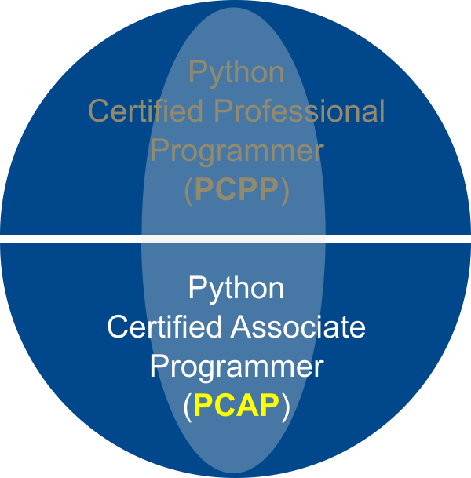

Certification
PCAP | Python Certified Associate Programmer certification is a professional credential that measures the ability to accomplish coding tasks related to the basics of programming in the Python language, and the fundamental notions and techniques used in object-oriented programming.
Professional certification
Associate level
Delivered through the network of Pearson VUE Test Centers
Digital transcript and paper certification
Complete the PCAP | Programming Essentials in Python course and get a 51% discount for the certification exam
Available from February 2018
© 2017 PYTHON Institute and/or affiliates | ALL RIGHTS reserved.
17

Slide 19

WHY LEARN PROGRAMMING
FOR SEVERAL REASONS:
To become a creator: a highly creative and powerful one. Go as far as your imagination lets you.
Strong programming skills are a hot commodity on the job market!
Boost your earning potential!
Programming is the language of the future.
Learning to program means learning to think in abstract and more precise ways.
It will help you do better in other areas!
It will be fun!
© 2017 PYTHON Institute and/or affiliates | ALL RIGHTS reserved.
18

Slide 20
Why learn PYTHON
FOR SEVERAL REASONS.
It is omnipresent – people use numerous Python-powered devices on a daily basis, whether they realize it or not.
There have been millions (well, actually billions) of lines of code written in Python, which means almost unlimited opportunities for code reuse and learning from well-crafted examples.
It is easy to learn – the time needed to learn Python is shorter than for many other languages; this means that it’s possible to start the actual programming faster.
It is easy to use for writing new software – it’s often possible to write code faster when using Python.
It is easy to obtain, install and deploy – Python is free, open and multiplatform; not all languages can boast that.
There is a large and very active Python community.
It will give you a solid foundation and allow you to learn other programming languages (e.g., C++, Java, or C) much easier and much faster.
It will be fun!
© 2017 PYTHON Institute and/or affiliates | ALL RIGHTS reserved.
19

Slide 21
Python EXAMPLES
DID YOU KNOW...?
Do you remember Battlefield 2, Battlefield 2142 and Battlefield Heroes – strategy and first person shooter games from EA DICE? Or Sid Meier’s Civilization IV? All these (and many other) games use Python for logic, server controls, or simply for many aspects of the game.
And what about the major websites and services? Dropbox? UBER? Spotify? Pintrest? BuzzFeed?
Yes. They were all written, to a greater or lesser extent, in Python. Other examples?
Internet Applications (BitTorrent, Jogger Publishing Assistant, TheCircle, TwistedMatrix)
3D CAD/CAM (FreeCAD, Fandango, Blender, Vintech RCAM)
Enterprise Applications (Odoo, Tryton, Picalo, LinOTP 2, RESTx)
Image Applications (Gnofract 4D, Gogh, imgSeek, MayaVi, VPython)
Mobile Applications (Aarlogic C05/3, AppBackup, Pyroute)
Office Applications (calibre, faces, Notalon, pyspread)
Personal Information Managers (BitPim, Narval, Prioritise, Task Coach, WikidPad)
Source: https://wiki.python.org/moin/PythonProjects
© 2017 PYTHON Institute and/or affiliates | ALL RIGHTS reserved.
20

Slide 22
PYTHON EXAMPLES
Python is a great choice for:
Web and Internet development (e.g., Django and Pyramid frameworks, Flask and Bottle micro-frameworks)
Scientific and numeric computing (e.g., SciPy – a collection of packages for the purposes of mathematics, science, and engineering; Ipython – an interactive shell that features editing and recording of work sessions)
Education (it’s a brilliant language for teaching programming! And that’s why we’re offering this course to you)
Desktop GUIs (e.g., wxWidgets, Kivy, Qt)
Software Development (build control, management, and testing – Scons, Buildbot, Apache Gump, Roundup, Trac)
Business applications (ERP and e-commerce systems – Odoo, Tryton)
And that’s just the beginning…
Source: https://www.python.org/about/apps

Slide 23
KEY TAKEAWAYS
PCAP | Programming Essentials in Python is developed by the Python Institute;
The course introduces students to computer programming using the Python language;
The course aligns withthe Python Institute PCAP | Python Certified Associate Programmer certification;
The Python Institute provides all contents;
The course is available in NetSpace;
Students who successfully complete the course and pass the final test will receive a 51% discount for the PCAP | Python Certified Associate Programmer certification exam at Pearson VUE.
Visit www.pythonsinstitute.org for more information about the certification program.
© 2017 PYTHON Institute and/or affiliates | ALL RIGHTS reserved.
22

