Slide 1
IT Essentials 6.0
Overview
Jorge Leiton
Product Manager
January 2016

Slide 2

Contents
1
Overview
2
Course Design
3
4
5
6
Scope and Sequence
Equipment
Instructor Training
Virtual Learning Tools
Notes:
We’ll begin with a high-level view of our ITE curriculum. Additional topics include instructor training and equipment required for the course.

Slide 3
Overview

Slide 4

IT Essentials 6.0
Subtitle: Size 24, Left Aligned
A comprehensive overview of computer hardware and software with an introduction to advanced concepts
Designed for students pursuing careers in IT who want practical knowledge of how different types of computing devices work
Interactive learning experience with hands-on labs, assessments that provide immediate diagnostic feedback.
Cisco Packet Tracer activities are designed for use with Packet Tracer 6.2 and support alignment with the new CompTIA A+ certification objectives
Introduce the student to computer and mobile devices hardware and software, as well as operating systems, networking concepts, IT security, and troubleshooting
Available in netacad.com with improved user interface and navigation features

Slide 5
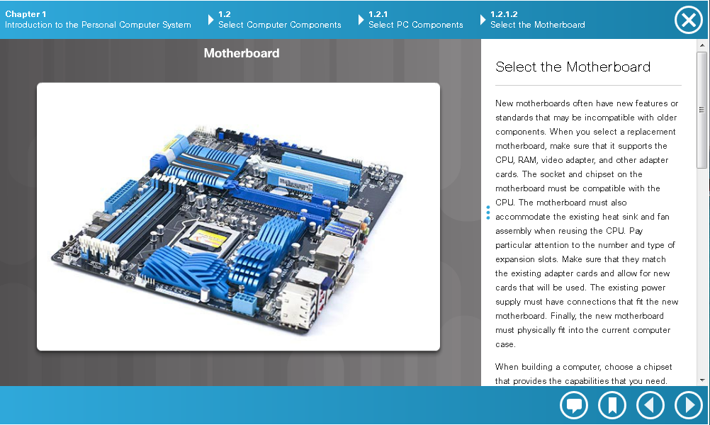
Content Changes in 6.0
  Aligns with updated CompTIA A+ 200-901 and 200-902 certification exams
  Focus on the skills needed to perform the job, not on the specific features and functions of different operating systems
  Updated and expanded content in: cybersecurity, mobile devices, troubleshooting and a variety of operating systems
  New topics added to align with certification changes:
  Mac OS (OS X) and Windows Phone
  Data Centers and Cloud Computing
  Networked Host Services
  Basic Linux CLI commands
  Motion Sensors, Touchpads, Smartcard readers
  Windows 8 & 8.1
  Aligns to latest version of Packet Tracer,
  PT 6.2

Slide 6
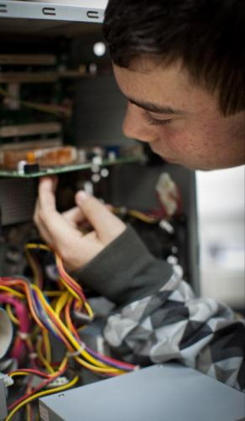
Benefits for Students
Offers a comprehensive introduction to the IT industry
Provides a comprehensive introduction to the IT industry and in-depth exposure to personal computers, hardware, and operating systems
Learn by doing: hands-on activities and labs help students become familiar with how to safely and securely install, configure, maintain, upgrade, and troubleshoot computer systems
Anytime learning: course text, assignments, quizzes, and discussions are supported on mobile devices
Immediate feedback on assessment questions helps students monitor progress and reinforces learning
Helps students prepare for CompTIA A+ certification exams
Supports development of career skills needed to succeed in entry-level IT jobs

Slide 7


Who Should Enroll?
Students seeking career-oriented, entry-level hardware and software skills to prepare for careers in technical support roles and information technology (IT)
Students who want to gain skills and working knowledge of how computers work, how to assemble computers, and how to troubleshoot hardware and software issues
Students at many education levels and types of institutions including high schools, secondary schools, universities, colleges, career and technical schools, and non-traditional learning environments such as community organizations

Slide 8
Course Proficiency
Nov 2015
CCNP Routing & Switching
1-3
CCNA Routing
& Switching
(3-4)
CCNA Security
Advanced
Mobility Fundamentals Series
NDG
Introduction to Linux I & II
CCNA Routing
& Switching
(1-2)
Smart Grid (German)
IT Essentials
NDG Linux
Essentials
Intro to Cybersecurity
Intro to
the Internet of Everything (IoE)
Entrepreneurship
Entry-level
Get Connected
Packet Tracer
Know How
Intro to IoE
Summary Podcast
Be Your
Own Boss
OS & IT
Networking
Security
Technology & Packet Tracer
Internet of Everything
Entrepreneurship

Slide 9
Course Design

Slide 10
New CompTIA A+ Certification Exams
2012 Edition
2015 Edition
220-801
220-901
220-802
220-902
New certification exams were announced in December 2015
220-800 series exams will be available until June 30, 2016
Both the 220-901 and 220-902 exams must be passed for CompTIA A+ certification
Student vouchers are available for 900-series exams through the CompTIA Authorized Partner Program
Notes:
To ensure alignment with certification exams, NetAcad has performed a detailed analyses of the exam objectives from CompTIA

Slide 11
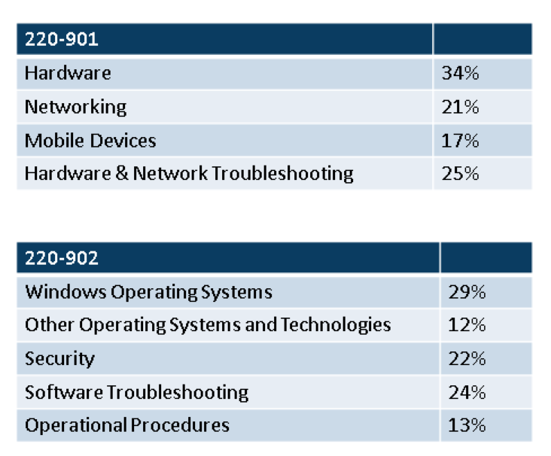
CompTIA A+ certification exams topic updates
Key differences between the CompTIA A+ 800 series (220-801 and 220-802) and the A+ 900 series (220-901 and 220-902) include:
• Expansion of mobile device coverage -- Mobile devices are covered in both the 901 and the 902 exams with mobile device hardware on the 901 exam and mobile device applications, OSs and security on the 902 exam. The ability to troubleshoot problems specifically related to mobile devices has also been added. Of the 8 new objectives added, 5 are related to mobility.
• Greater emphasis on troubleshoot -- In the 800 series there was a single troubleshooting section on the 802 exam. It represented 36% of that exam or 18% of the total certification. In the 900 series, troubleshooting represents 28% of the first exam and 24% of the second for a total of 26% of the total certification.
• A variety of operating systems -- The 900 series features a Windows OS domain along with a second OS-focused domain. The second OS-focused domain includes mobile OSs (Android, iOS and Windows Phone) and introduces an objective requiring a foundational understanding of Mac OS and Linux.
• Continued cybersecurity emphasis -- There is both a deepening in the level of objectives as well as an overall increase in security-related objectives in other domains.
Notes:
Key differences between the CompTIA A+ 800 series (220-801 and 220-802) and the A+ 900 series (220-901 and 220-902)include:
• Expansion of mobile device coverage -- Mobile devices are covered in both the 901 and the 902 exams with mobile device hardware on the 901 exam and mobile device applications, OSs and security on the 902 exam. The ability to troubleshoot problems specifically related to mobile devices has also been added. Of the 8 new objectives added, 5 are related to mobility.
• Greater emphasis on the ability to troubleshoot -- In the 800 series there was a single troubleshooting section on the 802 exam. It represented 36% of that exam or 18% of the total certification. In the 900 series, troubleshooting represents 28% of the first exam and 24% of the second for a total of 26% of the total certification.
• A variety of operating systems -- The 900 series features a Windows OS domain along with a second OS-focused domain. The second OS-focused domain includes mobile OSs and introduces an objective requiring a foundational understanding of Mac OS and Linux.
• Continued cybersecurity emphasis -- While the security domain weighting remains at 22% of the second exam, there is both a deepening in the level of objectives as well as an overall increase in security-related objectives in other domains.

Slide 12
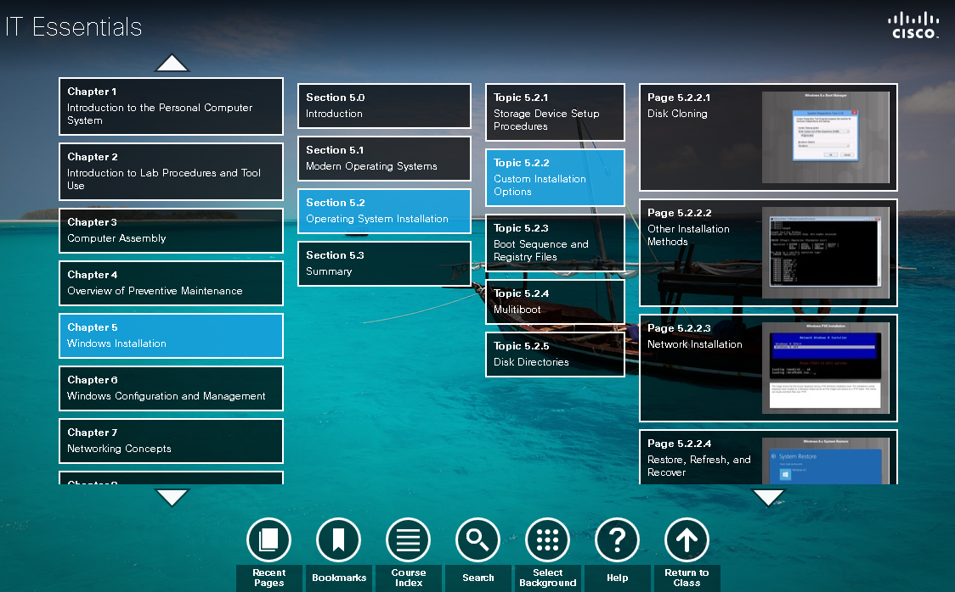
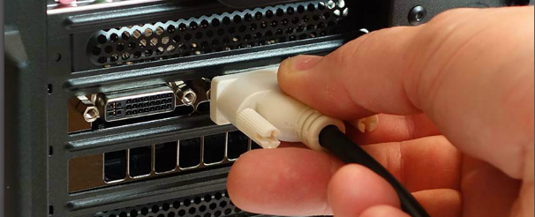
IT Essential 6.0 Course Design
Easy-to-navigate graphical user interface
14 chapters, modifiable chapter quizzes and chapter exams
29 Interactive Activities
6 Packet Tracer activities. PT 6.2 or higher required
99 hands-on and paper-based labs
1 skills assessment using equipment to verify the development of course skills
1 pre-test, 1 practice final exam, 2 final exam forms with field test pool items.
2 Certification Practice Exams, one for A+ 901 and one for A+ 902
14 chapters containing accessible text and media transcripts.
14 videos with closed captioning (CC)
Certificate of Completion

Slide 13
Scope and Sequence

Slide 14
IT Essentials 6.0 Content Updates
ITE 5.0 | ITE 6.0
Chapter 1: Intro to the Personal Computer | Chapter 1: Introduction to the Personal Computer
Chapter 2: Lab Procedures and Tool Use | Chapter 2: Introduction to Lab Procedures and Tool Use
Chapter 3: Computer Assembly | Chapter 3: Computer Assembly
Chapter 4: Overview of Preventive Maintenance | Chapter 4: Overview of Preventive Maintenance
Chapter 5: Operating Systems | Chapter 5: Windows Installation
 | Chapter 6: Windows Configuration and Management
Chapter 6: Networks | Chapter 7: Networking Concepts
 | Chapter 8: Applied Networking
Chapter 7: Laptops | Chapter 9: Laptops and Mobile Devices
Chapter 8: Mobile Devices | Chapter 10: Mobile, Linux and OS X Operating Systems
Chapter 9: Printers | Chapter 11: Printers
Chapter 10: Security | Chapter 12: Security
Chapter 11: The IT Professional | Chapter 13: The IT Professional
Chapter 12: Advanced Troubleshooting | Chapter 14: Advanced Troubleshooting
Notes:
14
First chapter grouping
remains the same. Some older technology has been removed, while some new technology has been added
Second chapter group
The v5 Operating Systems chapter has been divided into 2 chapters to address the enormous amount of information that is covered, as well as the number of labs.
The v5 networking chapter has been divided into Networking Concepts and Applied Networking due to the amount of material that was in the chapter.
Third Chapter group
The Mobile Devices chapter has also been divided. The information for mobile device hardware has been moved into the laptop chapter. This decision was made, in part, because CompTIA groups mobile devices with laptops in their objectives.
The new OS objectives for Linux and OS X have been combined with the Mobile device Software (iOS and Android) to complete Chapter 10.
Forth chapter group
Remains the same. New content has been added to the security chapter including:
Basic Cloud Concepts
Services Provided by Networked Hosts

Slide 15
IT Essentials 6.0 Course Outline
Course Chapters |  | Goals
Chapter 1 | Introduction to the Personal Computer | Select the appropriate computer components to build, repair, or upgrade personal computers.
Chapter 2 | Lab Procedures and Tool Use | Explain the purpose of safe working conditions and safe lab procedures.
Chapter 3 | Computer Assembly | Install components to build, repair, or upgrade personal computers.
Chapter 4 | Preventive Maintenance and the Troubleshooting Process | Explain how to perform preventive maintenance and troubleshooting on personal computers.
Chapter 5 | Windows Installation | Perform installation of Microsoft Windows operation systems.
Chapter 6 | Windows Configuration and Management | Perform configuration, management, maintenance, and troubleshooting of Microsoft Windows operating systems.
Chapter 7 | Network Concepts | Explain the operation of networks.
Chapter 8 | Applied Networking | Configure devices to connect to LANs, the Internet, and Cloud services.
Chapter 9 | Laptops and Mobile Devices | Explain how to configure, repair, upgrade, maintain and troubleshoot laptops and mobile devices.
Chapter 10 | Mobile, Linux, and OS X Operating Systems | Explain how to configure, secure and troubleshoot mobile, Mac, and Linux operating systems.
Chapter 11 | Printers | Install a printer to meet requirements.
Chapter 12 | Security | Implement basic host, data, and network security.
Chapter 13 | The IT Professional | Explain the roles and responsibilities of the IT professional.
Chapter 14 | Advanced Troubleshooting | Troubleshoot advanced hardware and software problems.

Slide 16
IT Essentials 6.0 Course Objectives
After completing the course, students will be able to perform the following tasks:
Select the appropriate computer components to build, repair, or upgrade personal computers. | Configure devices to connect to the Internet and Cloud services.
Explain how to correctly use tools and safely work in a lab. | Explain how to use, configure, and manage laptops and mobile devices.
Install components to build, repair, or upgrade personal computers. | Explain how to configure, secure and troubleshoot mobile, OS X, and Linux operating systems.
Explain how to perform preventive maintenance and troubleshooting on personal computers. | Install and share a printer to meet requirements.
Install Windows operation systems. | Implement basic host, data, and network security.
Perform management and maintenance of Windows operating systems. | Troubleshoot advanced hardware and software problems.
Configure computers to communicate on a network. | Explain the roles and responsibilities of the IT professional.

Slide 17
For More Information
Latest documents are posted on the IT Essentials Resources page
  Scope and Sequence
  FAQs
  Datasheet
  At-A-Glance
  Overview Presentation
  Release Notes
Visit CompTIA for A+ certification information

Slide 18
Equipment

Slide 19
ITE 5.0 Equipment Requirements
Focuses on Microsoft Windows 7, Windows 8 and 8.1. Only one Microsoft operating system installation media is required to complete the curriculum labs.
NDG NETLAB+ can be used to complete the majority of labs (available in April 2016).
Minimum Requirements
Curriculum requirements:
Ratio of one Lab PC per student
Lab PC Hardware Requirements:
1 PC Case with 300W power supply
Intel or AMD CPU, 1 gigahertz (GHz) or faster with support for PAE, NX, and SSE2
1 gigabyte (GB) RAM (32-bit) or 4 GB RAM (64-bit) (2 X 1GB or 2 X 2GB suggested)
60 GB hard drive (minimum); 80 GB or more (recommended)
1 DVD-ROM (minimum), DVDR, or BD/BDR
1 PCI, PCIe (recommended), or AGP video card
Detailed equipment information is available in the Instructor Lab source files and the ITE Equipment List located in the IT Essentials resources folder on netacad.com
Lab PC Repair Tools
• Phillips and Flathead screwdriver
• Electrostatic discharge (ESD) wrist strap and cord
• Safety glasses, Lint-free cloth and a Flashlight
• Thermal compound
• Wire cutters, RJ-45 Crimpers, Cable strippers and a modular cable tester
Additional Required Lab Equipment
• 1 Internet connection for Internet searches and driver downloads
• 1 printer or integrated printer/scanner/copier for the class to share
• 1 wireless router with WPA2 support for the class to share
• 2 Wireless network adapters (compatible with the above wireless router) for the class to share
• Various USB flash drives for moving files between computers in the labs.
Notes:
Purchase enough separate components or complete computers to meet the minimum specifications as outlined. The Lab PCs must only be capable of installing the required operating systems in a timely manner; they are not required to run at commercial speeds or perform processor-intensive applications such as complex graphics.
It is acceptable to use older machines as Lab PCs. Please keep the machines and components consistent, if possible.

Slide 20

Typical Lab Layout
Lab size of 12-15 students for hands-on lab activities
  Recommend ratio of 1 Lab PC per student
Some lab activities require the student Lab PCs to be connected to a local network
2 instructor workstations
  1 connected to Internet to search for and download files
  Other instructor workstation used for hands-on lab demonstrations
Notes:
For the best student learning experience, we recommend a typical lab size of 12 to 15 students and a ratio of one Lab PC per student. A ratio of one Lab PC per two students is the minimum acceptable for the hands-on lab activities. Some of the lab activities require the student Lab PCs to be connected to a local network.
The computer lab should also include two instructor workstations. One instructor workstation should be connected to the Internet to search for and download files. The other instructor workstation can be used for lab demonstrations.
The student Lab PCs will be in various states of assembly and repair and are therefore not suitable for accessing the curriculum.

Slide 21
Instructor Training

Slide 22
ITE 6.0 Instructor Training Requirements
ITE 5.0 instructors
  No instructor training required
  Review of instructor resources recommended
New ITE instructors
  Required to complete training through an Instructor Training Center (ITC)
  Must successfully pass skills-based assessment
  Instructor Fast Track option available to those with prior subject matter knowledge
  Fast Track enrollment prerequisites (one or more of following):
    Hold a current, valid CompTIA A+ certification
    Formal evidence of one year of recent experience in computer repair field
    Formal evidence of having taught two classes in the subject area

Slide 23
Instructor Resources
Instructor Resources
Resource | Description | Location
Instructor Resource Spotlight | Webpage with links to helpful instructor resources | Offerings > IT Essentials > IT Essentials 6.0 Instructor Resource Spotlight
Overview PPT | Presentation explaining high level concepts, changes, and site navigation | IT Essentials resources folder (link available on IT Essentials page and Instructor Resource Spotlight)
Release Notes | Detailed description of changes from previous version
ITE 6.0 Planning and Teaching PPT | One presentation for each chapter covering objectives, teaching analogies, and best practices as well as the slides and tips for teaching course topics
Skills-Based Assessment | 1 zip file with eleven separate assessments for instructors to assign as one exam or individually

Slide 24
Virtual Learning Tools

Slide 25
Virtual Learning Tools
Two standalone tools are provided as supplemental material with the curriculum in the IT Essentials resources folder
  Virtual Desktop
  Virtual Laptop
Designed to supplement classroom learning and provide interactive learning opportunities
Both provide a virtual “hands-on” experience where physical equipment access is limited
Enable students to virtually disassemble and reassemble desktops and laptops
The following slides demonstrate the Virtual Laptop introductory tutorial
Note: Support for these tools has been discontinued
Notes:
The Virtual Laptop and Virtual Desktop are standalone tools designed to supplement classroom learning and provide an interactive “hands-on” experience in learning environments with limited physical equipment. Hands-on labs are still an essential element of the course.

Slide 26
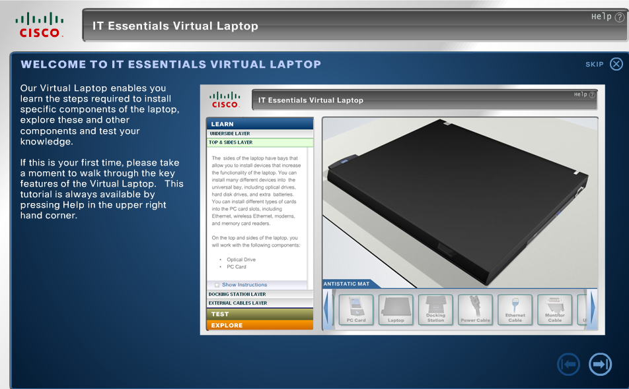
Virtual Laptop Tutorial
Or click the Skip button to go directly to using Virtual Laptop
Click the arrow to view the brief tutorial

Slide 27
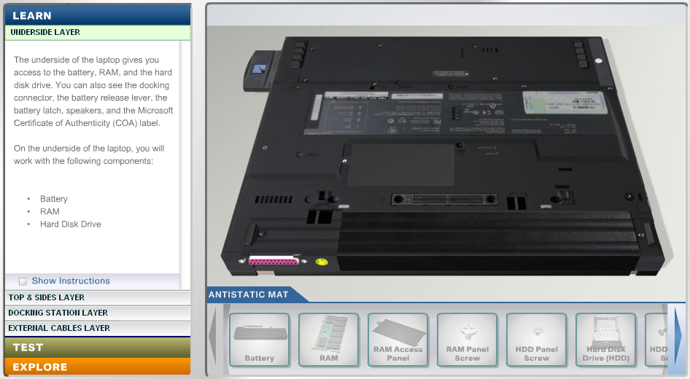
The Three Modes
Step-by-step instructions for removing and installing components
Learn mode
Self-check for understanding
Test mode
Information about laptop features and components
Explore mode
Notes:
The three modes of the Virtual Laptop Tool:
Learn Mode walks you through the removal and installation of select components of the laptop.
Test Mode allows you to remove and install select components without any assistance.
Explore Mode gives you information about many features and components of the laptop.

Slide 28
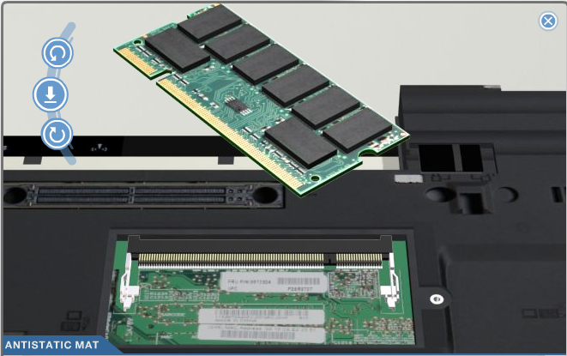
Aligning and Installing Components
Notes:
Some components need to be properly aligned before you can install them. Alignment of components is only required in the Learn Mode and in the Test Mode.
When a component requires alignment, the alignment tool pops up automatically. Click the clockwise and counterclockwise buttons to turn the component until you believe it is properly aligned. The Install button looks like an arrow pointing down. Click the Install button to install the component. If the component is not properly aligned then the Install button will show a red X. If the component is aligned, then clicking the Install button will begin the animation of the installation of the component. Once a component is properly installed, it will be grayed out on the antistatic mat.

Slide 29
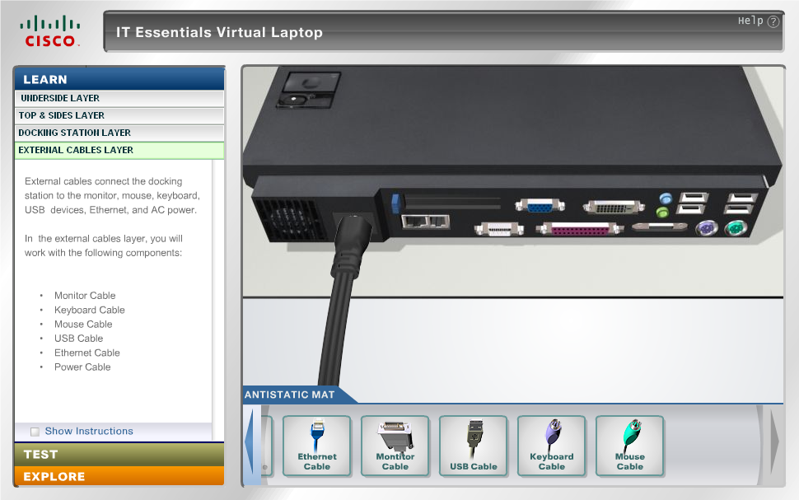
Learn Mode: External Cables Layer
Notes:
The last layer is the External Cables Layer.
External cables connect the docking station to the monitor, mouse, keyboard, USB devices, Ethernet, and AC power.
To successfully complete this layer, you will connect the monitor cable, the keyboard cable, the mouse cable, the USB cable, the Ethernet cable, and the power cable to the docking station.

